Slide 1

Sales Analysis Report
Supermarket analysis January 2019 – march 2019

Slide 2
Problem Statement
After checking the dataset given to me, I discovered that the Gross margin percentage of the supermarket was at 4.76%, which is relatively low, indicating that costs of goods sold are high.
This means that the supermarket is barely earning any profit at all. This is mostly common for businesses which are in the retail or groceries line. Therefore, I drafted out the following key focus:
Sales
Profits
Customer ratings
Payment method
Popular Product line

Slide 3
Project Objectives
Determine the total sales in the supermarket. This includes the sales of each product line, customer type, gender and branch.
To determine the profit generated by each product line, customer type, gender and branch.
Identify most used payment method
Most popular product line and branch
Ascertain average customer satisfaction/ Ratings

Slide 4
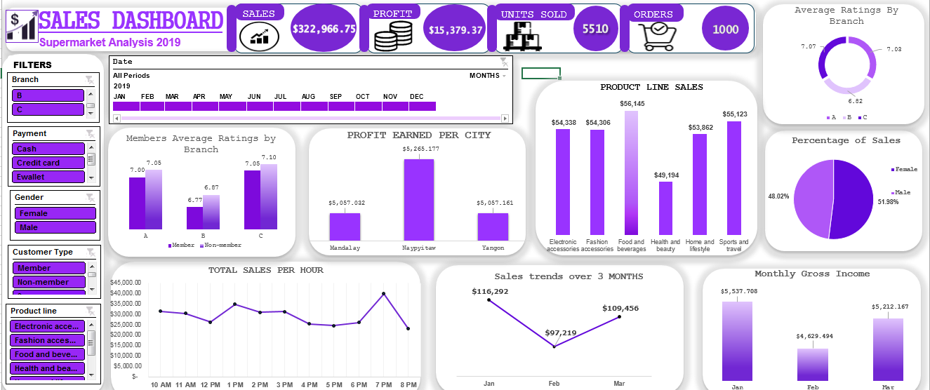
Dashboard:

Slide 5
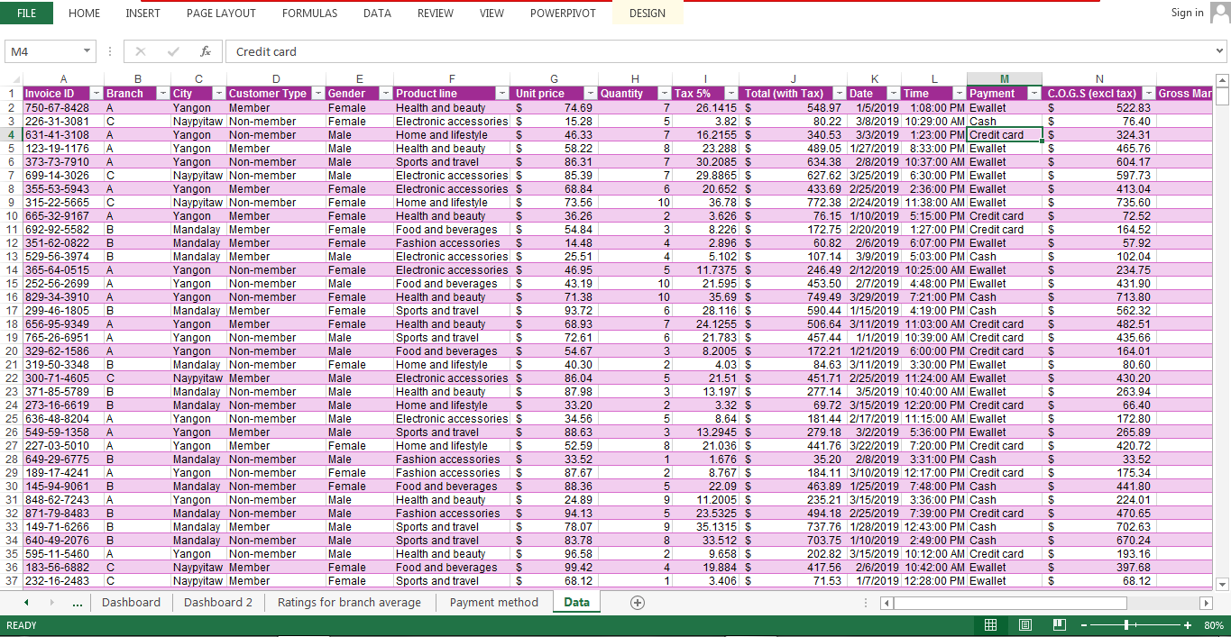
Data Set:

Slide 6
Analysis and Insights: Sales Performance
Total sales recorded is $322,966.75. January had $116,292 sales making it the peak sales in 2019 so far, meanwhile February had the lowest at $97,219.
Branch C outperforms other branches with the highest total sales at $110,569.
Food and beverages has the highest sales at $56,145 followed by Sports and travel at $55,123.
Females contributed 51.985 of the total sales while males contributed 48.02%.
It was discovered that the peak sales hour is 7pm.

Slide 7
Sales Insights and Visualization:
Branch Analysis: Branch C outperforms the other branch by having a total sales of $110,569, while branch A and B had $106,200 and $106,198 respectively.
Sales Time: It was discovered that the peak sales hour is 7pm.

Slide 8
Sales Insights and Visualization:
Product line Analysis: Food and beverages at $56,145 has the highest sales followed by sports and travel at $55,123.
Time Period: In 3 months, the supermarket had a total of $322,966.75. However, January had the highest sales at $116,292, followed by March at $109,456. February had the lowest total sales at $97,219.
Gender: Females contributes 51.98% of the total sale while males contributes 48.02%.

Slide 9
Sales Insights and Visualization:
Customer Type: Customers with membership card tends to purchase more from the supermarket compared to non-members. However in January, more sales was calculated for customers without membership card.

Slide 10
Profitability
Total profit earned so far is $15,379.37
Monthly gross income are as follows: January - $5,537.708, February- $4,629.494, March - $5,212.167.
Highest profit was earned by Branch C at $5,265.177.

Slide 11
Profit Insights and Visualization:
The total profit earned is $15,379.37. However, January has the highest income at $5,537.708, followed by March. February had the lowest.
Naypitaw earned the highest profit at $5,265.177

Slide 12
Profit Insights and Visualization:
Customer Type: Customers with membership card generated more income compared to non-members. However, in January non-members had a slightly higher profit than members.

Slide 13
Customer Ratings:
The average customer rating is 6.97, indicating a decent satisfaction rate considering that there were 1000 orders in total.
Non-members have the highest customer ratings compared to members.

Slide 14
Customer Ratings:
Food and beverages receive the highest ratings which is 7.11 at average, while Home and lifestyle have the lowest, 6.84.

Slide 15
Payment Method:
Cash and E-wallet are the most preferred payment method, followed by Credit Card.
1896 quantities were paid for using cash, 1892 were paid for using E-wallet, while credit card had the lowest with 1722 quantities.

Slide 16
Key Findings:
Gross Margin of 4.76% is relatively low, indicating that costs are high.
Food and beverages is the most popular product line among all customers.
Members are highly valuable customers, however non-members has the highest average rating.
More customers use Cash and E-wallet as a means of payment in the supermarket

Slide 17
Recommendations:
To improve profitability, it is advisable to reduce the cost of goods sold, this can be done by negotiating cheaper prices with suppliers for bulk purchases.
Increasing the quantities of each product line can also increase profits.
Increase marketing efforts in the top-performing branch which is Branch C.
Focus on converting normal ( non-members) customers to members through loyalty programs.

